Slide 1
Aims for the Session
•To give parents and carers practical ideas of how to support your child’s reading.
•To share helpful resources.
•To stress the importance of working together to ensure all children can read at the highest level.

Slide 2
Aims for your child
•To encourage a love of reading,
•To develop fluency and independence,
•To develop comprehension and understanding
To be able to read fluently in order to ‘read to learn.’

Slide 3
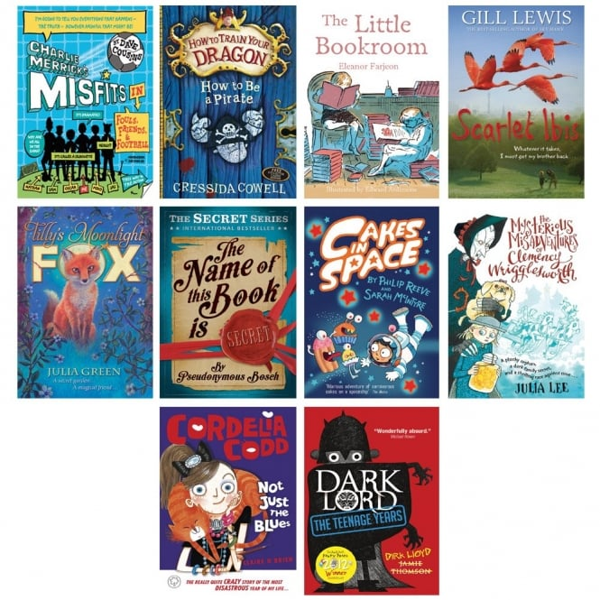
What do your children enjoy reading?

Slide 4
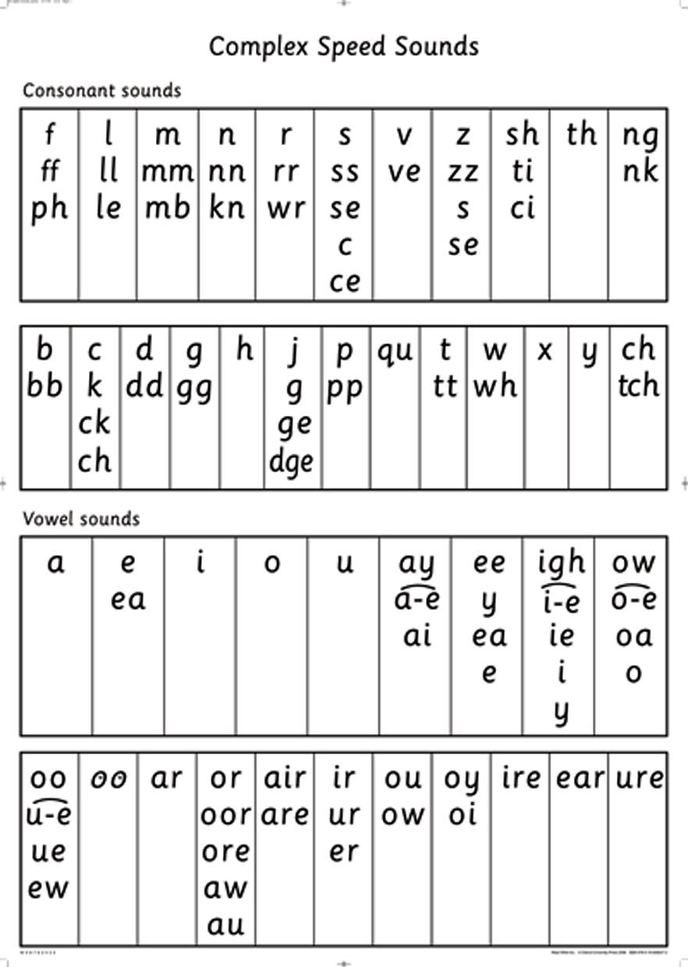
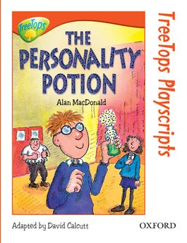
How we teach reading at Sacred Heart Catholic School
• Phonics
• Guided Understanding
• Home reading

Slide 5
Why is reading so important?
Evidence suggests that there is a positive relationship between reading frequency, reading enjoyment and attainment.
• Reading enjoyment has been reported as more important for children’s educational success than their family’s socio-economic status
• There is a positive link between positive attitudes towards reading and scoring well on reading assessments
• Regularly reading stories or novels outside of school is associated with higher scores in reading assessments
• Evidence suggests that reading for pleasure is an activity that has emotional and social benefits.
Other benefits to reading for pleasure include: pleasure in reading in later life, increased general knowledge

Slide 6
The books your child brings home…
We ALL want the children experience success:
• We aim to provide books that are directly linked to the children’s reading ability– ‘banded books’
• We aim to use a variety of schemes and text-types

Slide 7
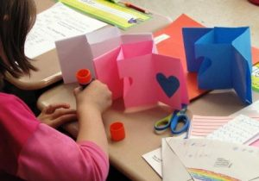
Reading at home with your child…
• Try to build this into your daily routine
Let your children see you read
Boys need to see that reading is something men do
Encourage children to read… anything(!) and ideally a range of genres and author
• Have a set space you can read in
• Remember, both reading the school book and reading to your child are important.
Make your own books
Make it fun!
Talk about books.
Sit and listen - don’t do chores around the reader!
Respect choices.

Slide 8
Before Reading
If it is the first time your child has read the book, look at the cover and title with them to predict what they think the book might be about. Make links to other books read with similar themes, the same characters and/or similar authors/illustrators. Give them time to flick through the book and read the blurb.

Slide 11
During reading
•Ask your child many questions about the characters in the book as you read the story
•Have your child use his/her finger to follow the direction of the text (top to bottom, left to right) •Have your child look at the sentences and see if he/she can find any of the sounds.
•Discuss the meaning of any unfamiliar words or words they do not understand.

Slide 15
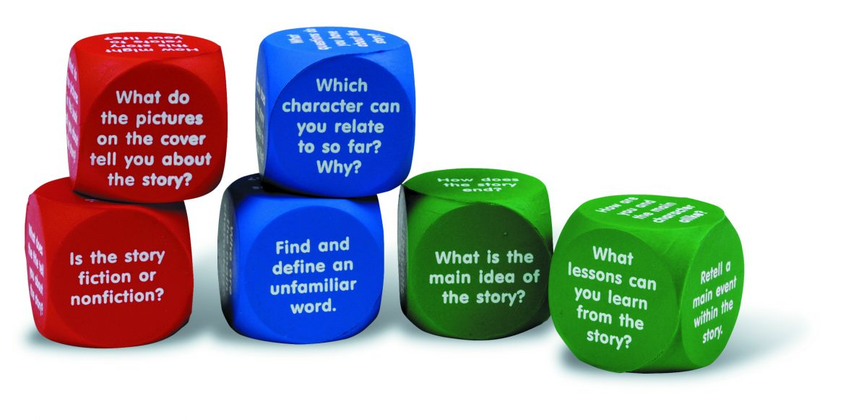
Reading for Meaning
There is always the opportunity to ask your child:
How is the character feeling at this point in the story?
Why is he/she feeling that way?
How do you know?
Sometimes children need help developing their feeling words vocabulary.

Slide 16
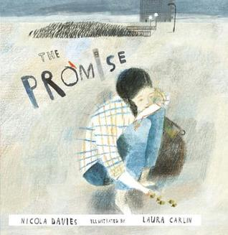

Slide 19
Think of something new you have learnt today about the importance of reading.
Consider one thing that you will try and do with your child this week to support their reading.
All the activities and this powerpoint will be on the school website.
Thank you for your continuing support!

