Slide 1
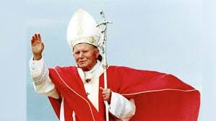
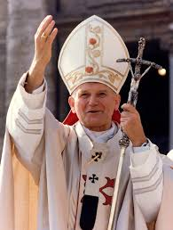
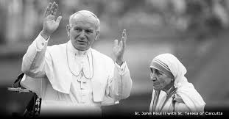
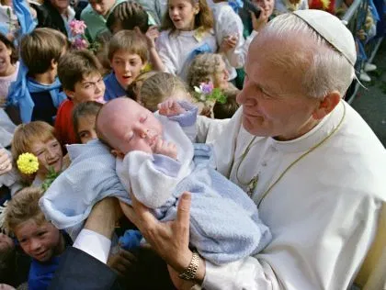
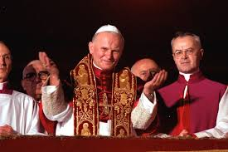
Saint John Paul II

Slide 2
How did he become Pope?

Slide 3
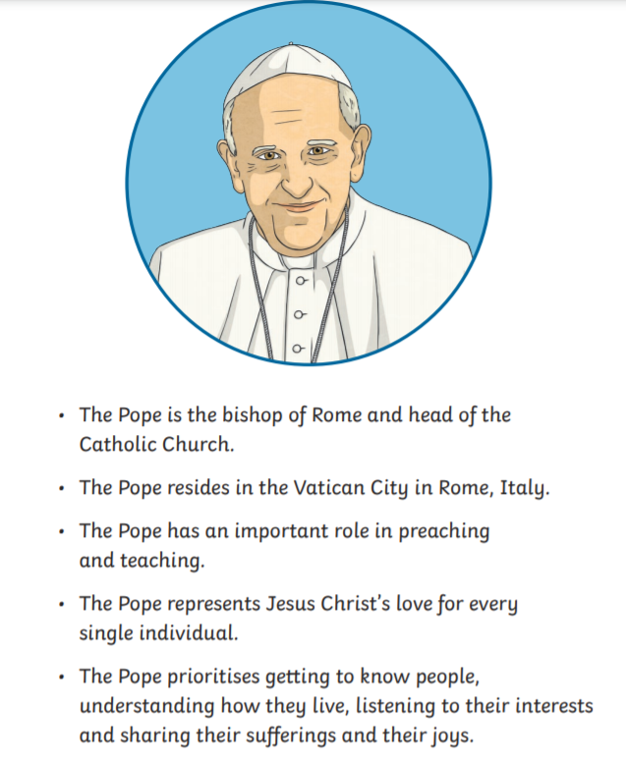
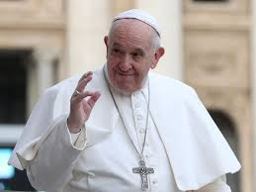
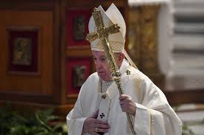

Slide 4
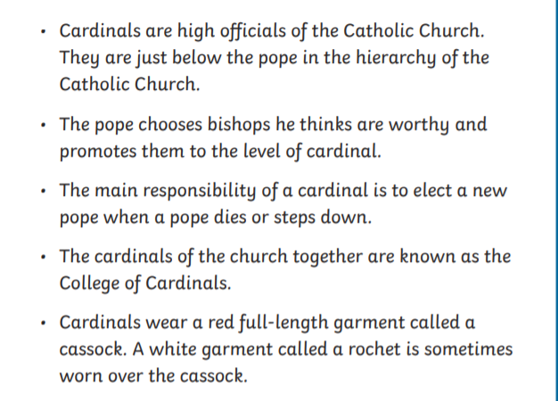
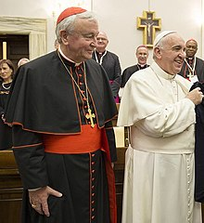
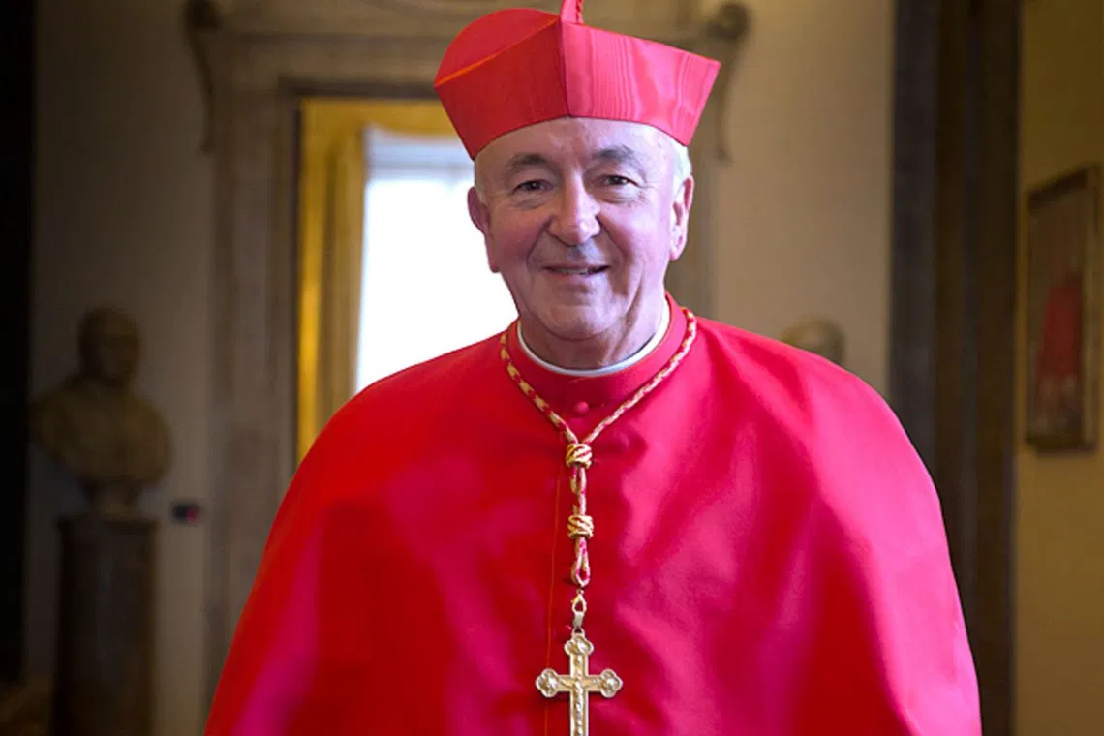

Slide 5
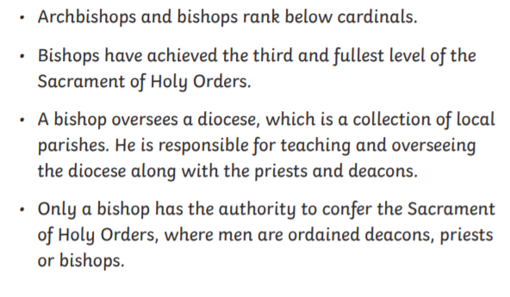
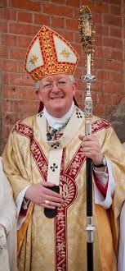
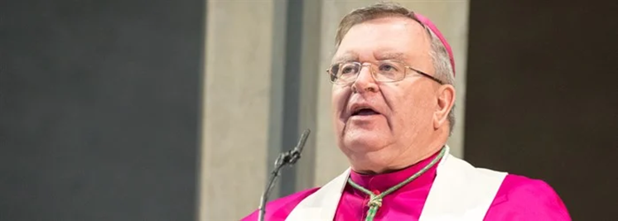
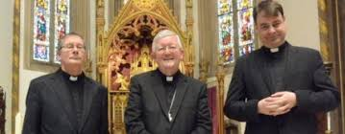
Archbishop Bernard Longley
On Friday 9 October the Archdiocese rejoiced at the episcopal ordinations of two new auxiliary bishops.
The Episcopal Ordination Mass for Bishops David Evans and Stephen Wright took place at noon in St Chad’s Cathedral, on the Feast of St John Henry Newman. This may well be the first time that two bishops have been ordained together in St Chad’s Cathedral.

Slide 6
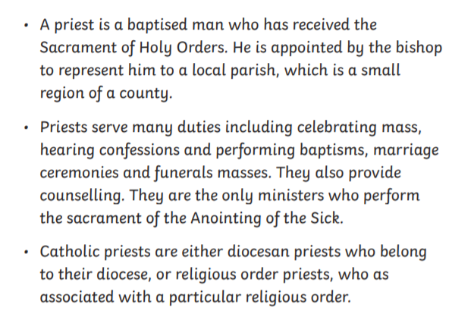
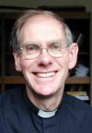
Fr Stephen is in charge of the Sacred Heart Parish in Aston, as well as St Joseph's in Nichells where in which he resides in.

Slide 7
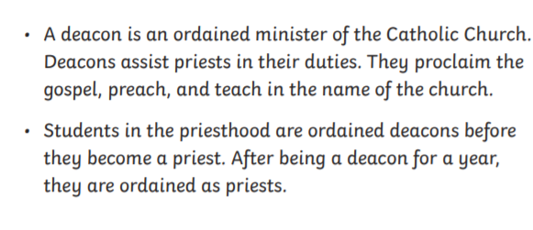
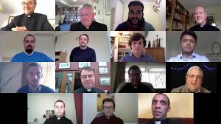

Slide 8
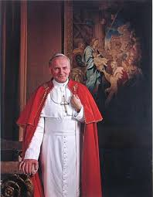
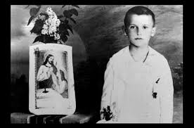
John Paul II was a pope of the Roman Catholic Church. The popes are the leaders of the church. John Paul II was the first non-Italian pope in 455 years. He served in the role from 1978 to 2005. In 2014 he was made a saint of the church.
John Paul was born Karol Józef Wojtyła on May 18, 1920, in Wadowice, Poland. His father was an officer in the Polish army. His mother died when he was eight years old. Wojtyła was a good student and athlete. He often helped the priest at the local church. Wojtyła graduated as the top student in his class and moved to Kraków, Poland, to attend a university there.
https://www.youtube.com/watch?v=y9lYvkmY874

Slide 9
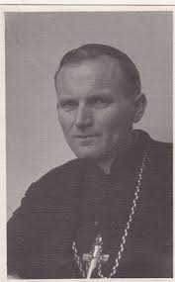
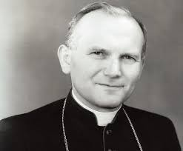
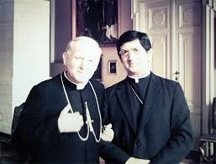
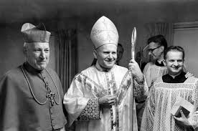
On September 1, 1939, World War II began when Nazi Germany invaded Poland. The Nazis closed the university and arrested some of the teachers. Wojtyła then went to work in a factory. However, he was able to take classes in secret.
After his father’s death in 1941, Wojtyła decided to become a priest. Again he had to study in secret. Wojtyła became a priest in November 1946. He went to Rome for further studies and then returned to Kraków. There he worked as a priest, taught classes, and earned another degree.
At this time, Poland was ruled by a communist government. There were many restrictions on religion. Wojtyła impressed church leaders with his ability to inspire people within these restrictions. He was made the archbishop of Kraków in 1963. Wojtyła was also chosen to take part in the Second Vatican Council (1962–65). The council was an important meeting of bishops from all over the world. The purpose of the meeting was to work on making the church more modern. Wojtyła distinguished himself there. He was made a cardinal, the highest-ranking bishop, in 1967.

Slide 10
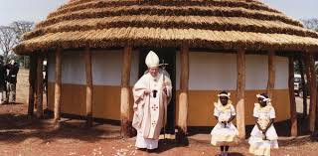
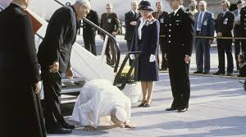
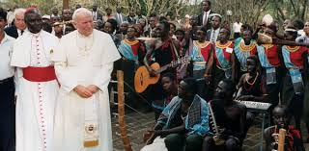
Wojtyła was elected pope in October 1978 and chose the name John Paul II. He began to travel almost immediately. John Paul travelled more than all other popes combined. John Paul thought it was very important for the church to stand for human rights and dignity and religious freedom. He felt strongly about this because of his experience with Nazi Germany and communist Poland.
John Paul preached that people should work for change in nonviolent ways. He inspired many people in Poland to call for the end of communism there. Eventually the government did allow elections. He was also the first pope to apologize to groups that had been wronged by Catholics, notably Jews and Muslims.
On May 13, 1981, John Paul was shot in an assassination attempt. He survived, but another attempt was made on his life one year later. In his later years John Paul had many health problems. He continued as pope, however, until his death on April 2, 2005, in Vatican City. He was canonized, or made a saint, on April 27, 2014. His feast day is October 22.

Slide 11
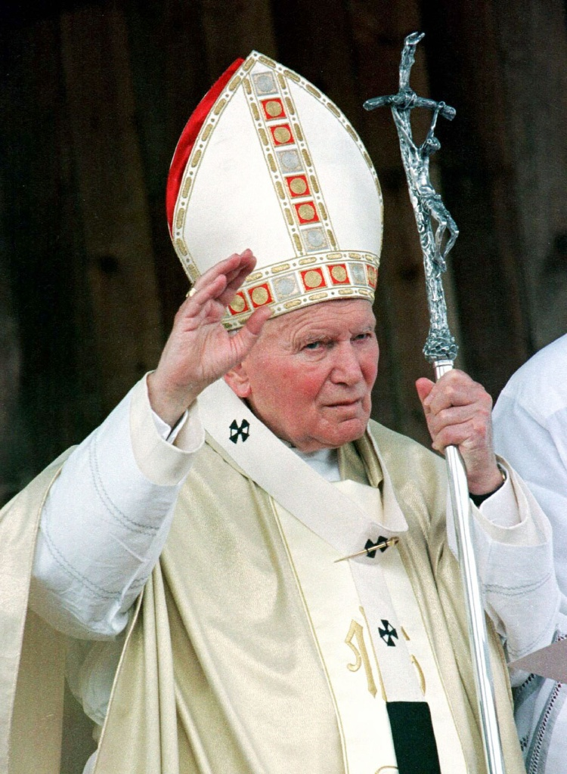
Throughout his life, Pope John Paul II was an avid sportsman, hiking and skiing even in his sixties. In 1992, however, his health began to decline. It was later revealed that he suffered from Parkinson’s disease, a degenerative disorder of the central nervous system. Near the end of his papacy, it became difficult for him to speak, and his poor health and physical suffering made public appearances difficult. Still, he bore his suffering patiently, and continued his pastoral work despite his physical pain. He entrusted his health to God, and joined his suffering with that of Christ.
Pope John Paul II died April 2, 2005, and he was declared blessed on May 1, 2011. He was declared a saint on April 27, 2014 along with Pope John XXIII. His feast day is October 22.

Slide 12
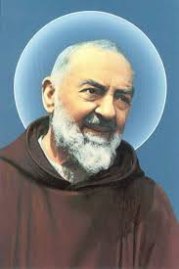
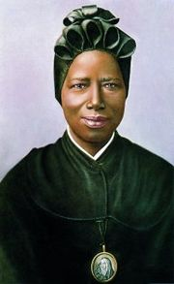
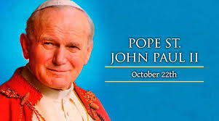
Pope St. John Paul II fast facts …
First non-Italian pope since Adrian VI (1522-23)
First Polish pope ever
Youngest pope since Pius IX (1846-78)
Third longest pontificate in history of the Church (nearly 27 years)
Most-travelled pope in history
First pope to visit a synagogue
First pope to visit a mosque
First pope to call for a day of pardon
First pope to add five new mysteries to the Rosary
He canonized over 400 Saints including St. Padre Pio, St. Juan Diego, St. Maximilian Kolbe, and St. Bakhita
He wrote an average of 3,000 pages a year during his papacy
He was seen by more people than any other person ever in human history
Marvel wrote a comic book about him

Slide 13
Now you can try to create your own fact file on Saint John Paul II.
Add facts or information you feel is important for others to know.
Think about why we remember him today?
What made him so special?
Why do you think he became a Saint?

