Slide 1
Wednesday
Press the speaker to hear your instructions for all maths lessons.

Slide 2
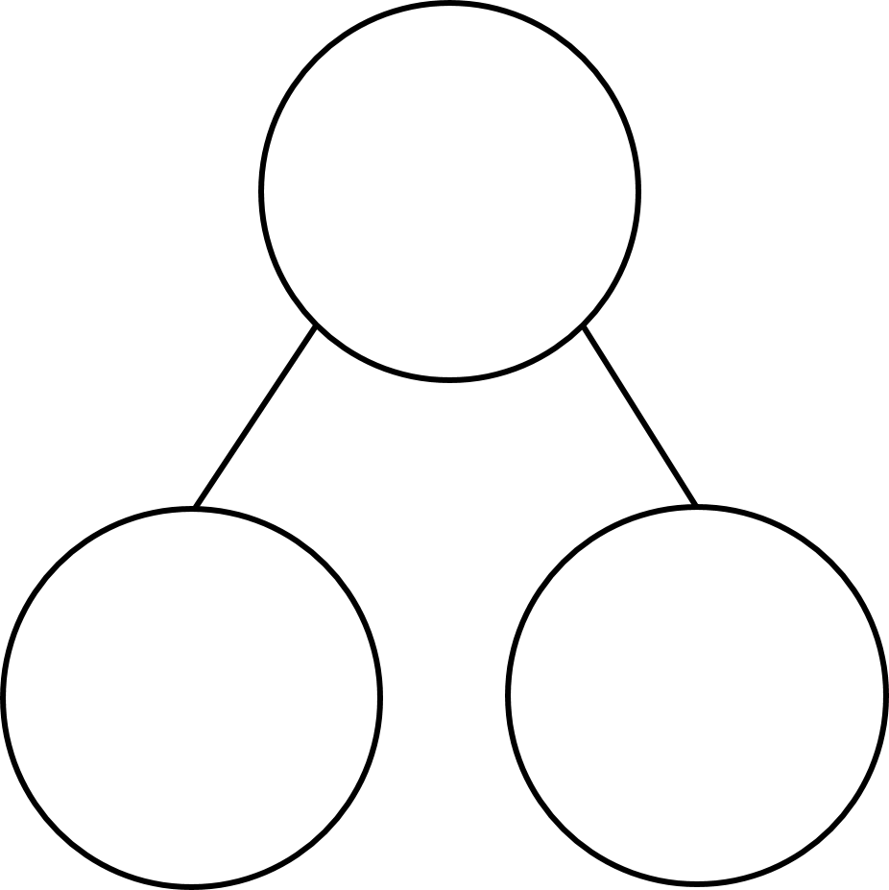
06/01/2021
Next Steps
Group 2
Round these numbers to the nearest 100
164
85
478
233
2) Complete the part whole model.
Group 1
Complete the sequence.
10, 20, 30, 40, _____, _____
answer
answer
answer
answer
2) How many tens are in 38?
answer
answer
answer
3) Complete the part-whole model.
72
185
answer
2 ones
answer
answer

Slide 3
Group 1
Group 2
Complete the sequence.
10, 20, 30, 40, _____, _____
Round these numbers to the nearest 100
164 200
85 100
478 500
233 200
2) Complete the part whole model.
50
60
2) How many tens are in 38?
3 tens
3) Complete the part-whole model.
72
185
e.g.
7 tens
2 ones
100
85

Slide 5
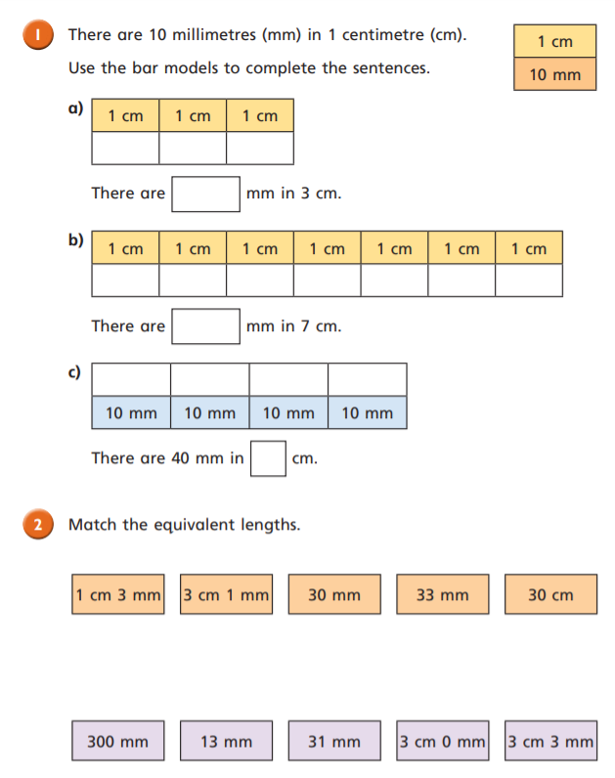
Equivalent Lengths – mm & cm
Click me for Q2
a
a
a
a
a
a
a
a
a
a
a
a
a
a
a
a

Slide 6
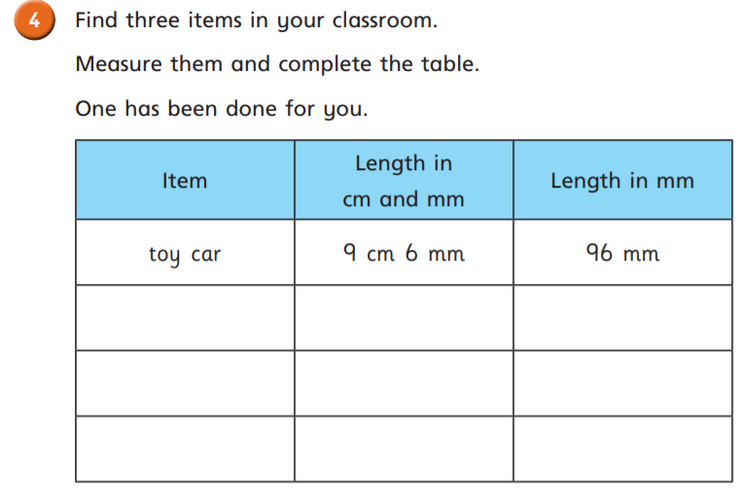
answer
a
a
a
answer
house
a
a
a
answer
answer
answer
answer
answer
answer
a
answer
answer
a
a
answer

Slide 7
Thursday

Slide 8
07/01/2021
Next Steps
Group 2
1) 235 + 345 =
2) 5289 + 1274 =
3) 4562 – 2231 =
Group 1
answer
Complete the sequence.
1,000 2,000 3,000 _______ ______
answer
2) How many thousands are in 4,832?
3) Complete the part-whole model.
answer
9,931
answer
931

Slide 9
Group 1
Group 2
Complete the sequence.
1,000 2,000 3,000 _______ ______
1) 235 + 345 = 580
2) 5289 + 1274 =6563
3) 4562 – 2231 =2331
4,000
5,000
2) How many thousands are in 4,832?
4 thousands
3) Complete the part-whole model.
9,931
9,000
931

Slide 11
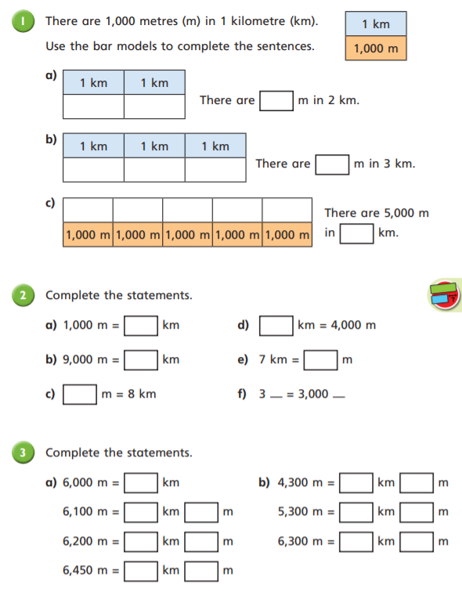
Kilometres
a
a
a
a
a
a
a
a
a
a
a
a
a
a
a
a
a
a
a
a
a
a
a
a
a
a
a
a
a
a
a

Slide 12
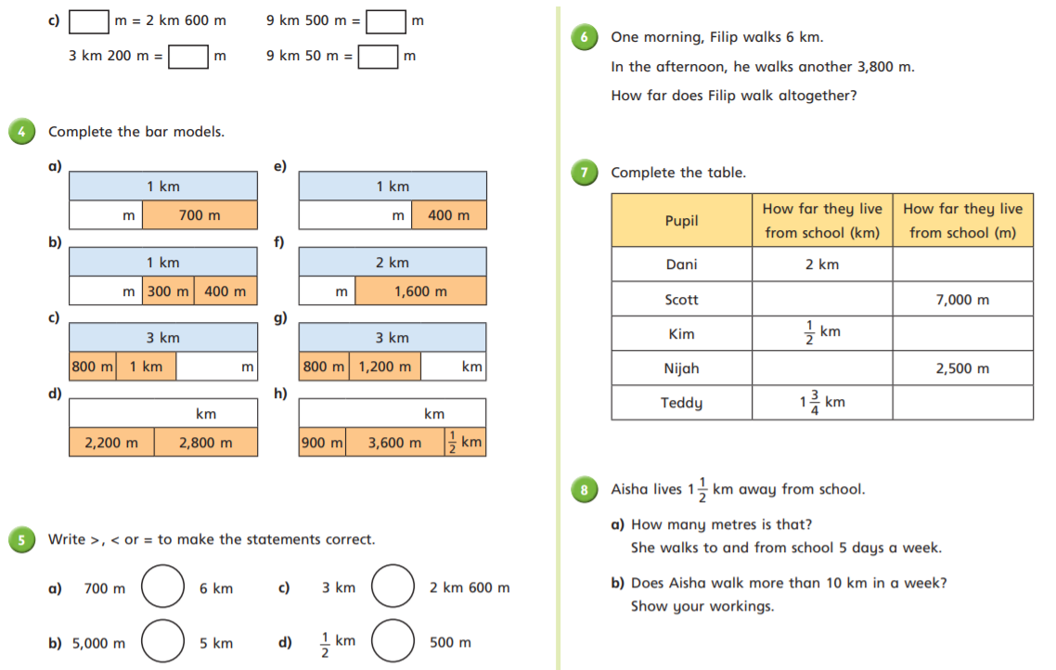
a
a
a
a
a
a
a
a
a
a
a
a
a
a
a
a
a

Slide 13
Friday

Slide 14
08/01/2021
Next Steps
Convert the measurements.
1 cm $=$ ______ mm
1 m $=$ ______ cm
1 km $=$ ______ m
2) 47 $+$ 25 $+$ 13 $=$
3) 128 cm $=$ 1 m $+$ ____ cm
answer
answer
answer
answer
answer

Slide 15
Convert the measurements.
1 cm $=$ ______ mm
1 m $=$ ______ cm
1 km $=$ ______ m
2) 47 $+$ 25 $+$ 13 $=$
3) 128 cm $=$ 1 m $+$ ____ cm
10
100
1,000
60 $+$ 25 $=$
85
28

Slide 17
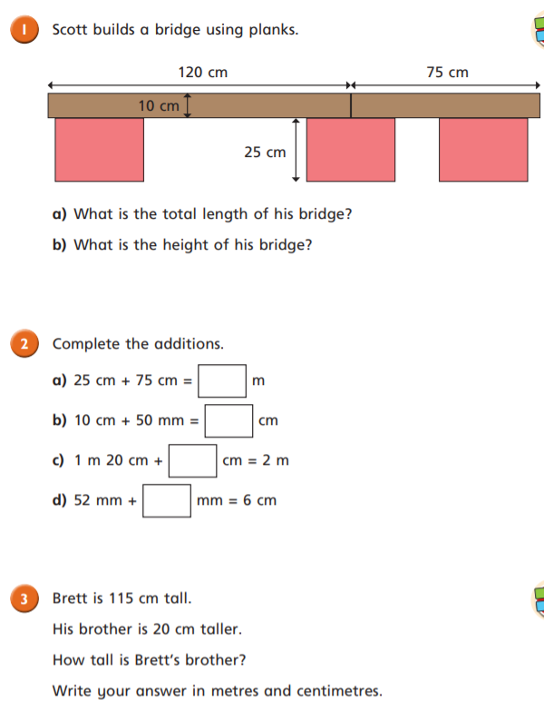
Adding Lengths
answer
answer
a
a
a
answer
a

Slide 18
answer
answer
answer
answer
answer
answer

