Slide 1
Maths Workshop
For
Parents
2022
Key Stage 1

Slide 2
Aims :
To give an overview of how maths is taught at Sacred Heart.
To share some of the practical resources we use here to teach maths .
To show and share some of the strategies you could use to support your children at home .
To provide time to look more closely at your child (ren)s year group . What are the maths objectives being taught ? How are these taught in school ? How can I support my child at home with maths ?
To answer any questions you may have about maths.

Slide 3
When children leave Sacred Heart we would like them to …..
Enjoy maths and see its relevance in ‘ THE REAL WORLD ‘
Have a growth mind-set about maths - developing a ‘can do / have a go’ approach
Secure a sound knowledge of number facts and a good understanding of the four operations.
Use this knowledge to carry out calculations mentally
Make use of diagrams and jottings to help record steps to solving a problem
Have an efficient , reliable written method for each operation
Mathematical thinking and reasoning – being able to choose efficient methods for a range of mathematical problems. They should have the skills to problem solve with confidence.

Slide 4
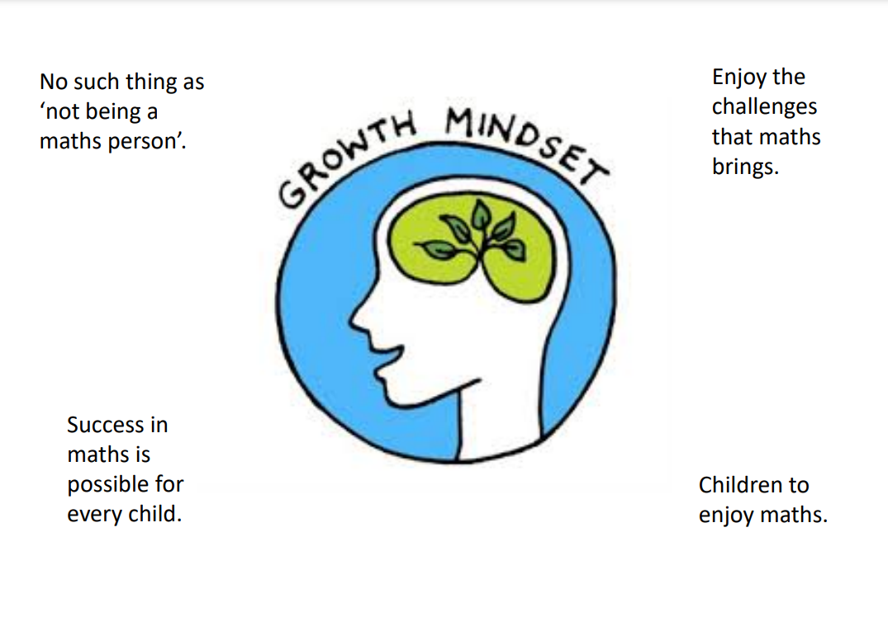
Developing a
We as adults should never show a negative attitude to maths

Slide 5
Number
Number is the key to all other aspects of maths. It includes
Counting
Understanding number
Knowing and using number facts
Calculating
Calculation Methods
The maths work that your children are doing at school may look different to the kind of ‘sums’ you remember.
Many parents express concerns about helping at home and showing wrong methods to their children
Our calculation policy outlines how maths is taught from Reception to Year 6 ( copies are available on the tables and on the school website )

Slide 6
Mastery Maths is based around the core principle of Concrete, abstract and pictorial representations

Slide 11
Foundation

Slide 14
Year 1
Addition
subtraction

Slide 21
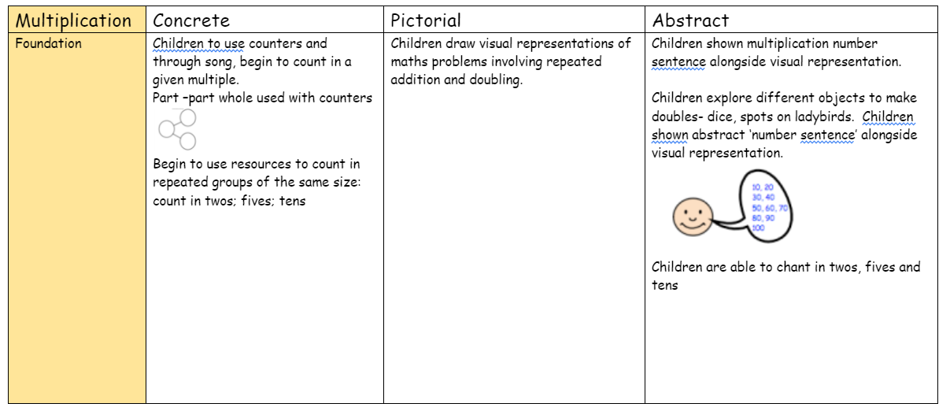

Slide 29
Year 2
Addition
subtraction

Slide 32
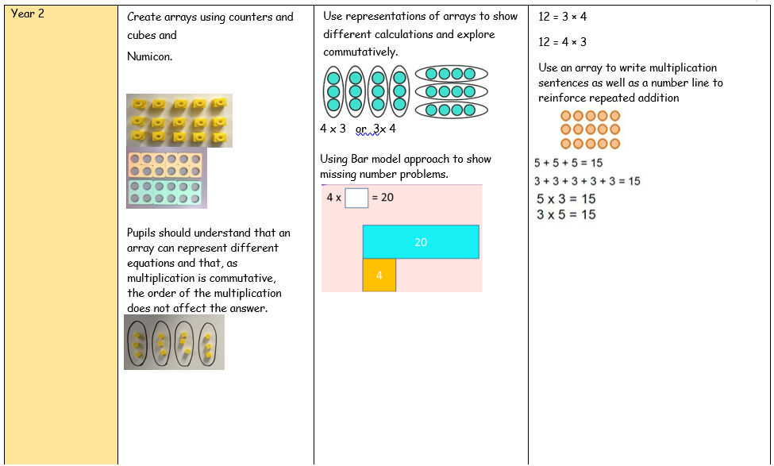
Commutative – can be done in any order

Slide 33
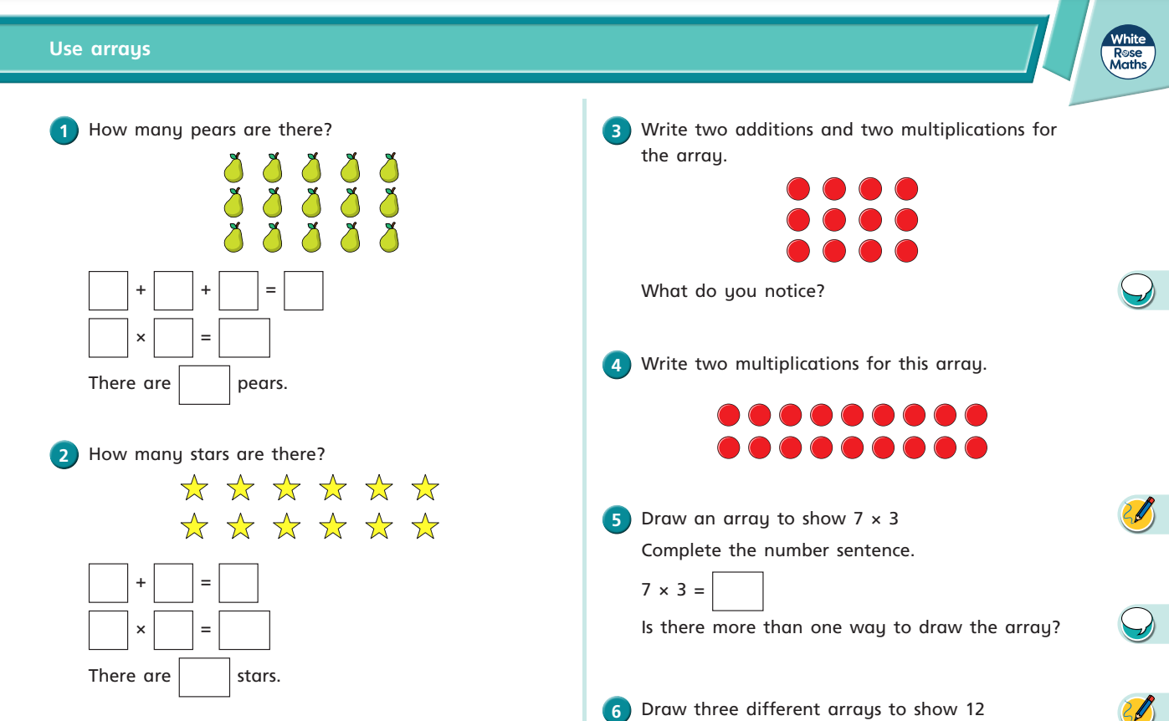

Slide 34
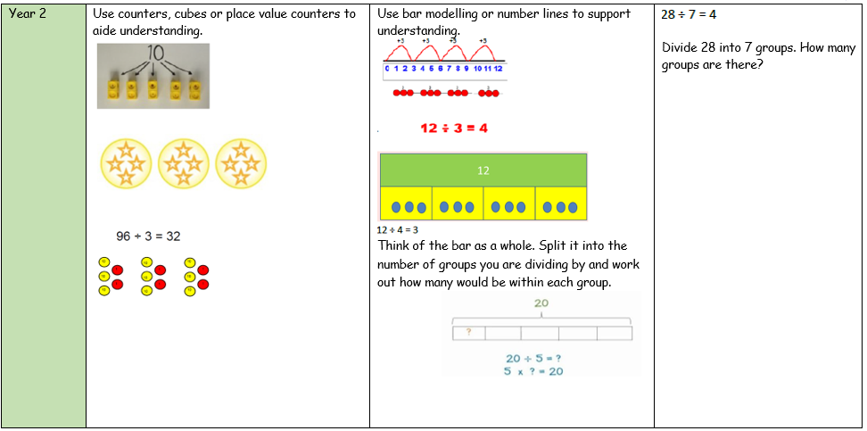

Slide 37
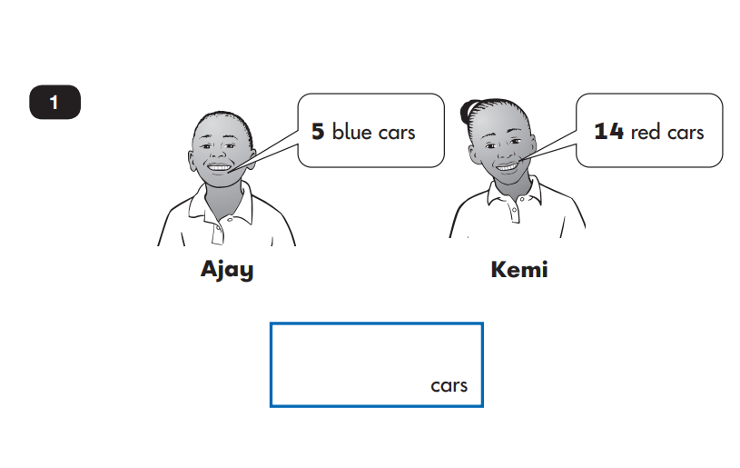
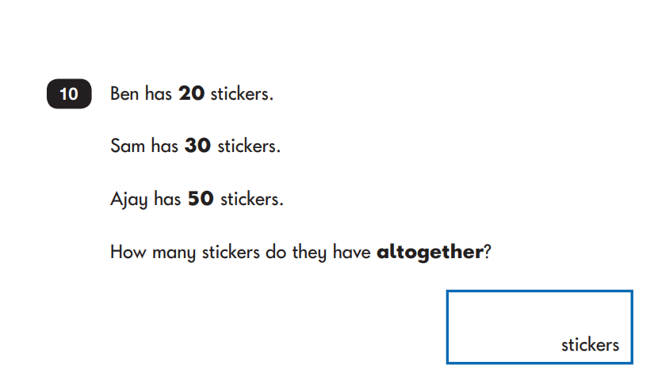
KS1 SAT’s
Addition and subtraction

Slide 41
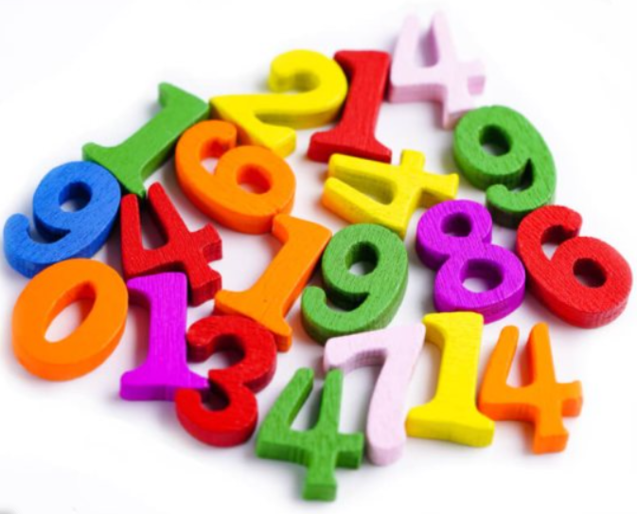
Any Questions ?
Thankyou for coming …….

