Slide 3
I’m counting in 2s.
Which number will I not say?
8 14
9 42
1 | 2 | 3 | 4 | 5 | 6 | 7 | 8 | 9 | 10
11 | 12 | 13 | 14 | 15 | 16 | 17 | 18 | 19 | 20
21 | 22 | 23 | 24 | 25 | 26 | 27 | 28 | 29 | 30

Slide 4
I’m counting in 2s.
Which number will I not say?
8 14
9 42
1 | 2 | 3 | 4 | 5 | 6 | 7 | 8 | 9 | 10
11 | 12 | 13 | 14 | 15 | 16 | 17 | 18 | 19 | 20
21 | 22 | 23 | 24 | 25 | 26 | 27 | 28 | 29 | 30

Slide 6
1 | 2 | 3 | 4 | 5 | 6 | 7 | 8 | 9 | 10
11 | 12 | 13 | 14 | 15 | 16 | 17 | 18 | 19 | 20
21 | 22 | 23 | 24 | 25 | 26 | 27 | 28 | 29 | 30
0
 |  | 10
 |  |  | 15
 |  |  |  | 20
 | 5

Slide 7
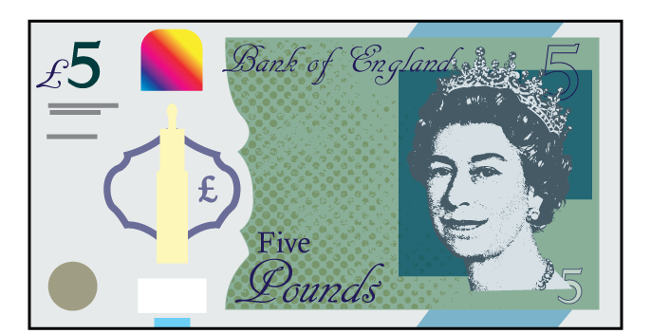
What can we count in 5s?
Have a think

Slide 8
0 | 1 | 2 | 3 | 4 | 5 | 6 | 7 | 8 | 9 | 10 | 11 | 12 | 13 | 14 | 15 | 16 | 17 | 18 | 19 | 20

Slide 9
Have a think
1 | 2 | 3 | 4 | 5 | 6 | 7 | 8 | 9 | 10
11 | 12 | 13 | 14 | 15 | 16 | 17 | 18 | 19 | 20
21 | 22 | 23 | 24 | 25 | 26 | 27 | 28 | 29 | 30
31 | 32 | 33 | 34 | 35 | 36 | 37 | 38 | 39 | 40
41 | 42 | 43 | 44 | 45 | 46 | 47 | 48 | 49 | 50

Slide 10
Have a go at questions 1 and 2 on the worksheet

Slide 11
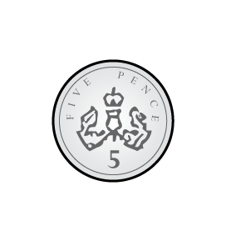
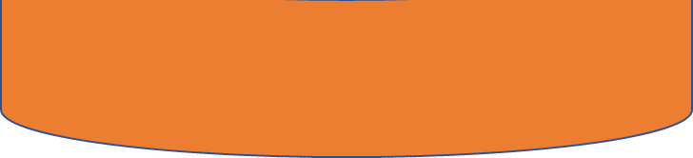
0
0
5
5
10
10
15
15
20
20
25
25
30
30
35
35
40
40
45
45
50
50
55
55
Notes:
You have been practicing counting in 2’s to 20
Let’s practice

Slide 12
Let’s count…
Notes:
All in columns Have 2,4,6,8, or 0 Skips a column

Slide 13
You decide…
Have a think
Notes:
All in columns Have 2,4,6,8, or 0 Skips a column

Slide 14
10
In silence…
Notes:
All in columns Have 2,4,6,8, or 0 Skips a column

Slide 15
Let’s count backwards…
Notes:
All in columns Have 2,4,6,8, or 0 Skips a column

Slide 16
Have a go at questions 3 - 5 on the worksheet

