Slide 1
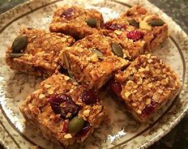
To create an advert for our healthy flapjacks

Slide 2
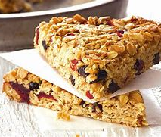
How will we entice the reader to buy our flapjacks?
We need to tell them what it is.
Delicious, nutritious, healthy, fruity flapjack.
Why should they buy it?
It is great for food on the go, will keep you full until lunchtime, is a good source of energy, can help with hunger.

Slide 3
Now we need to persuade our customers this is the flapjack for them.
Healthier option.
Good for your body, bones and muscles.
Healthier snack.
Good source of energy.
Packed full of vitamins and minerals.
Lower in fat and sugar than other flapjacks.

Slide 4
What is in our flapjack? Rolled oats Butter Golden syrup Dried cranberries Dates Dried apricots Raisins
Amazing new introductory offer.
Fantastic price.
Buy one, get one free.

Slide 5
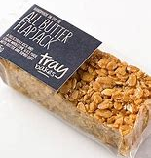
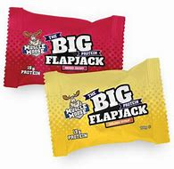
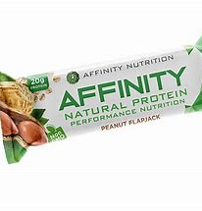
Unique recipe New design Homemade

